Slide 1
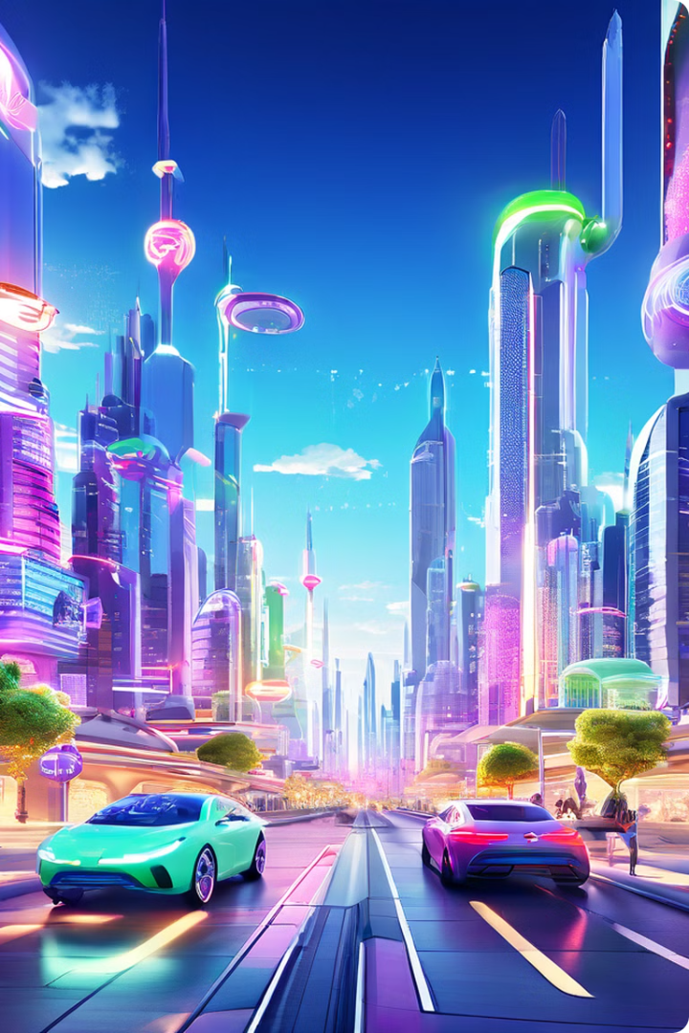

AI Stacks: A Glimpse into the Future
AI stacks are becoming increasingly sophisticated, enabling diverse applications. This presentation explores a few key AI stacks, highlighting their capabilities and potential impact.
mu
by muhammad umair

Slide 2
Local AI Microservices Development Stack
Benefits
Challenges
Examples
This stack provides flexibility and granular control, allowing developers to tailor AI solutions to specific needs.
This stack requires expertise in distributed systems and infrastructure management, demanding technical proficiency.
AI-powered recommendation engines, image recognition systems, and personalized chatbots built with microservices.
It facilitates rapid iteration and deployment, enabling efficient development cycles.
Managing scalability and resource allocation can become complex as the stack grows.

Slide 3

Serverless with OpenAI APIs
1
Simplicity
2
Scalability
This approach allows developers to focus on AI model development without managing infrastructure.
Serverless platforms automatically scale resources based on demand, ensuring efficient resource utilization.
3
Cost-Effectiveness
4
Examples
Pay-as-you-go pricing models provide cost optimization, reducing infrastructure costs.
AI-powered text generation, translation, summarization, and question-answering systems.

Slide 4
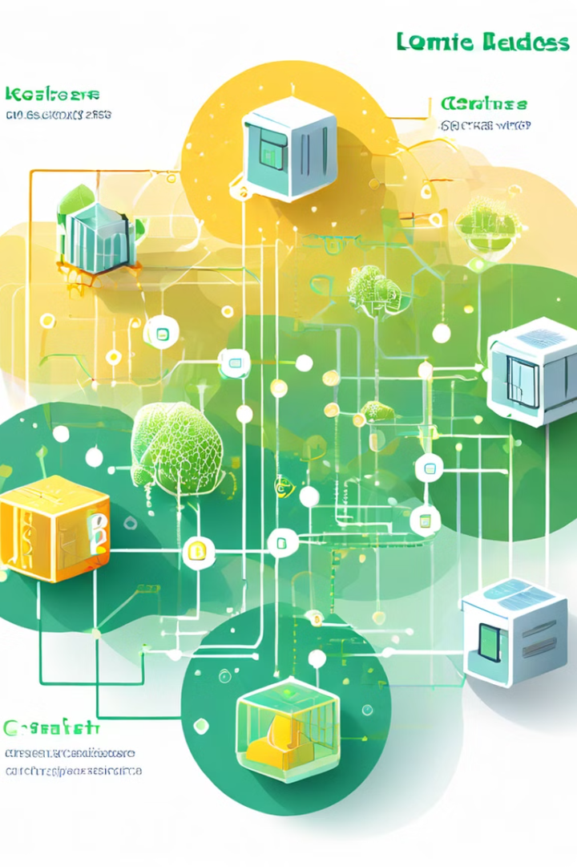
Custom AI Stack with PyTorch, Llama, and Kubernetes
Component
Role
PyTorch
Open-source machine learning library for building and training AI models.
Llama
Large language model for natural language processing, enabling sophisticated text generation and understanding.
Kubernetes
Container orchestration platform for managing and scaling AI workloads efficiently.

Slide 5




OpenAI GPTs Stack with Conversational Interfaces
GPTs
OpenAI's powerful language models, enabling natural language understanding and generation.
Conversational Interfaces
Chatbots and virtual assistants that interact with users in a natural, human-like way.
Applications
Customer service, education, entertainment, and more, facilitating human-machine interactions.

Slide 6

The Rise of Agentic AI: A New Era of Intelligent Collaboration
Autonomous Agents
Shared Goals
AI agents capable of independent actions, learning, and decision-making, working in collaboration with humans.
Humans and AI agents work together towards common objectives, leveraging their complementary capabilities.
Enhanced Productivity
AI agents automate tasks, provide insights, and assist humans, leading to increased efficiency and effectiveness.

Slide 7
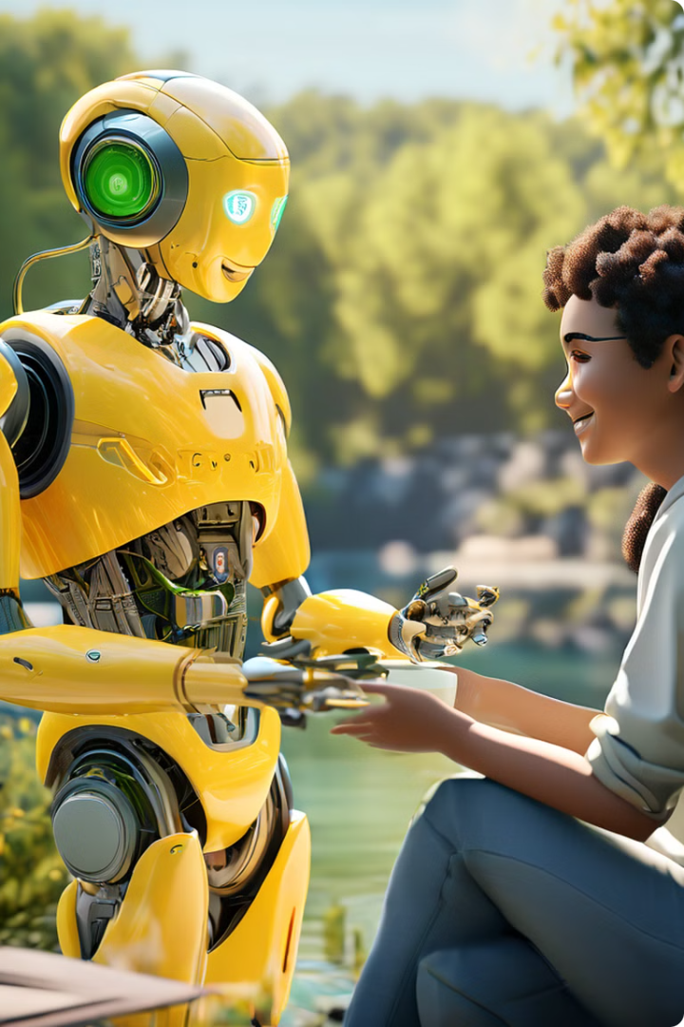




The Next Wave of AI: Humanoids and Physical AI
Physical Embodiment
Dexterous Manipulation
AI agents integrated into physical robots, capable of interacting with the real world.
Humanoid robots with advanced dexterity and fine motor skills, enabling complex tasks.
Cognitive Abilities
Human-Robot Interaction
AI-powered robots with advanced reasoning, problem-solving, and decision-making capabilities.
Seamless interaction between humans and robots, fostering collaboration and cooperation.

Slide 8

Conclusion and Key Takeaways
AI stacks are rapidly evolving, opening up exciting possibilities for innovation. By understanding different stacks and their strengths, developers can build AI solutions that address diverse challenges and drive progress.

